Slide 1
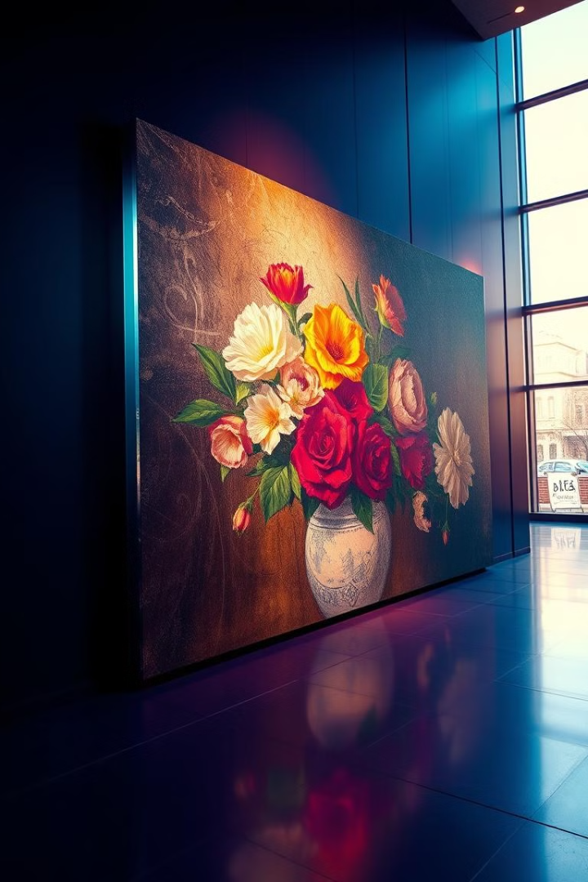
Image Restoration: Techniques and Approaches
Image restoration is a crucial aspect of digital image processing, aiming to recover lost or degraded information. This presentation delves into the challenges, techniques, and datasets involved in image restoration, ultimately exploring the innovative architectures and promising future directions.
By Team-1,
Mani Datt Mogadampalli (1005-21-733036)
Puli Venu (1005-21-733045)
KSPSVLN Siddardha Kumar Kavuri (1005-21-733058).

Slide 2

Problem Definition: Understanding the Challenges
1
Noise Reduction
2
Blur Removal
Digital noise, such as salt and pepper noise, can degrade image quality. Image restoration aims to reduce this noise while preserving important image details.
Motion blur, out-of-focus blur, and atmospheric blur can be challenging to remove. Restoration techniques aim to sharpen images and restore clarity.
3
Motion Deblurring
4
Enhancement
Motion deblurring is a computer vision and image processing task focused on removing or reducing the blur caused by the relative motion between a camera and the scene being captured.
Image restoration can enhance features such as brightness, contrast, and color saturation, making images more visually appealing and informative.

Slide 3
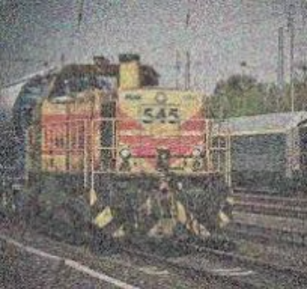
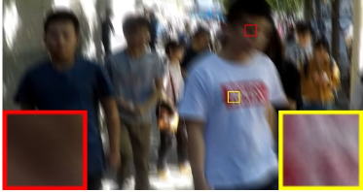
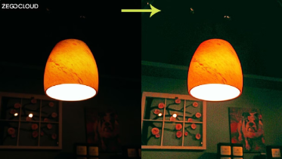
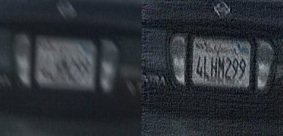
Sample Images:
Noised Image
Blurred Image
Low Light Images
Motion Deblurring

Slide 4
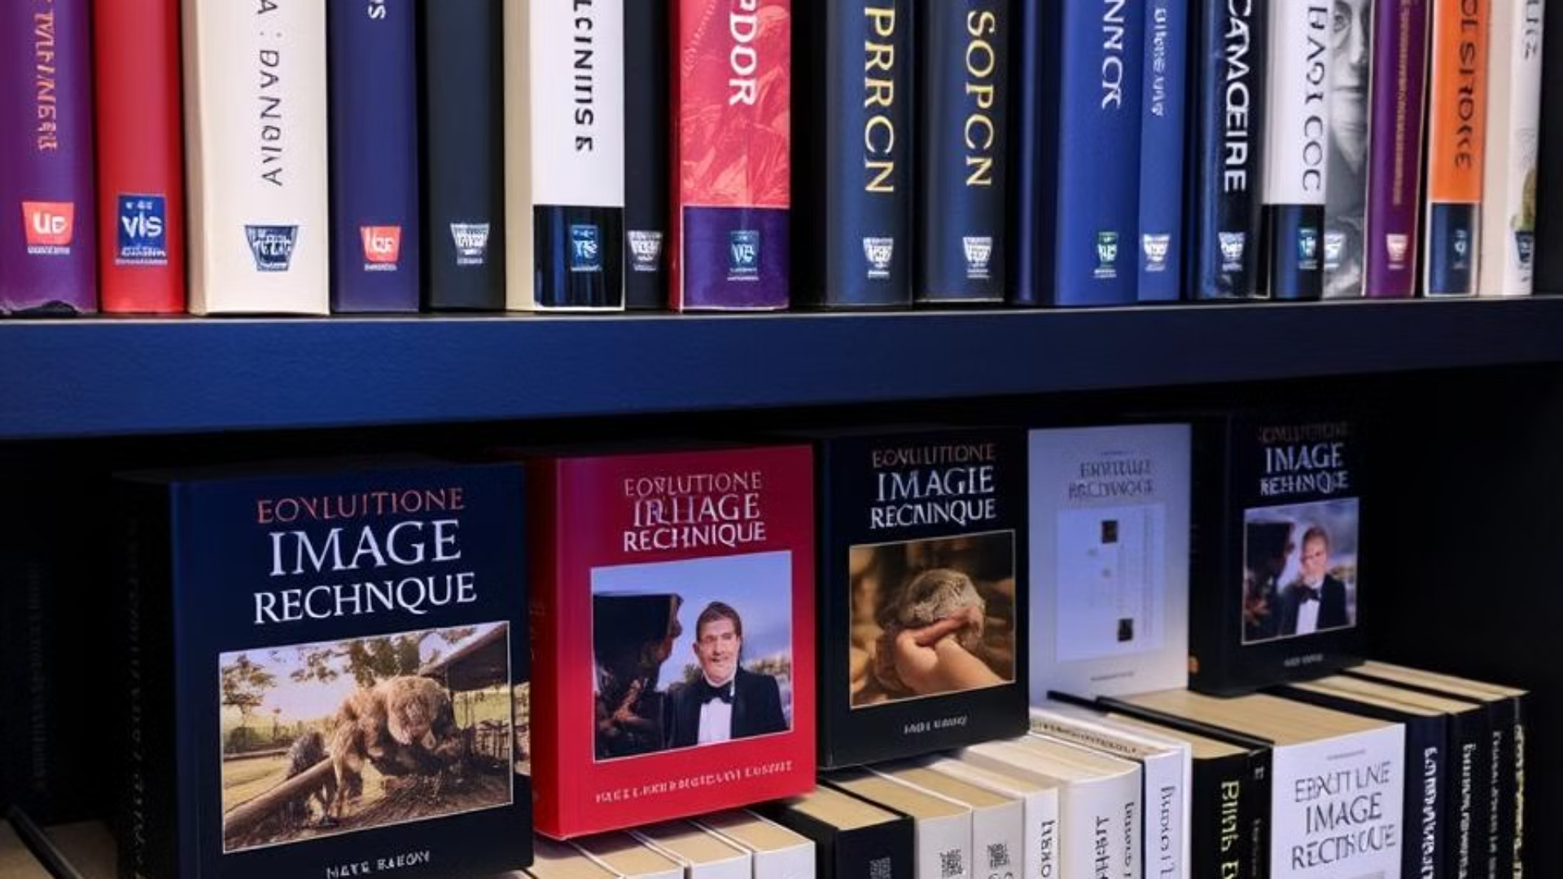



Datasets for Image Restoration: Exploring the Landscape
SID (See in the Dark) and LOL (LOw Light)
A collection of images for low light enhancement dataset contains 5094 raw short-exposure images, each with a corresponding long-exposure reference image.
SIDD (Smartphone Image Denoising Dataset)
SIDD is an image denoising dataset containing 30,000 noisy images from 10 scenes under different lighting conditions using five representative smartphone cameras.
GoPro and HIDE
The GoPro dataset for deblurring consists of 3,214 blurred images with a size of 1,280×720 that are divided into 2,103 training images and 1,111 test images. HIDE is a motion-blurred dataset that includes 2025 blurred images for testing. It mainly focus on pedestrians and street scenes.

Slide 5
Literature Survey: Existing Techniques and Methodologies
Traditional Methods
Modern Techniques
Filtering: Techniques like Gaussian, median, and Wiener filtering are commonly used for noise reduction.
Transformers: long-range operations in image restoration, enhancing feature representation and improving restoration accuracy across tasks.
De-blurring: Techniques like inverse filtering and Wiener filtering are employed for addressing motion blur and out-of-focus blur.
Generative Adversarial Networks (GANs): GANs have demonstrated exceptional capabilities in generating high-quality restored images.
Inpainting: Techniques like exemplar-based inpainting and patch-based inpainting are used to fill in missing data.
Autoencoders: Autoencoders learn compressed representations of images, allowing for effective restoration of degraded images.

Slide 6
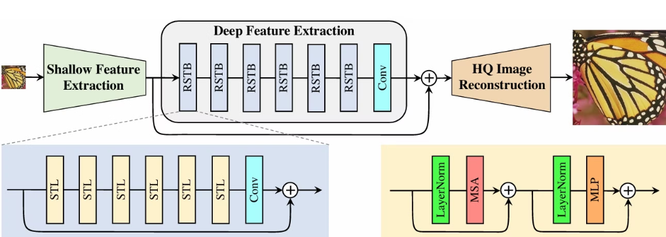
Available Techniques
1) Swin Transformer:
It is a combination of CNN and Transformers which are used to extract the shallow and deep features of the inputimage and produce a high quality image as the output.

Slide 7
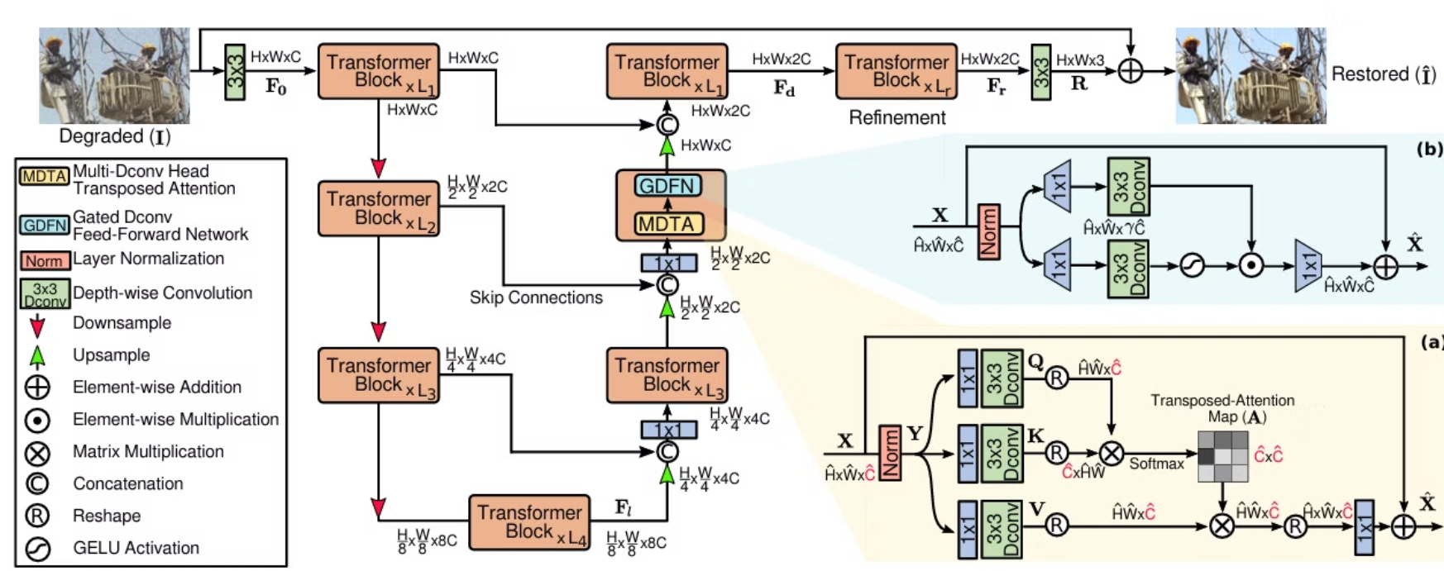
Available Techniques
2) Efficient Transformer
It is architecture which first encodes or downsamples the image and the decodes or upsamples the image the decrease the effect of noise and retains the features of image. Useful for denoising and deraining data.

Slide 8
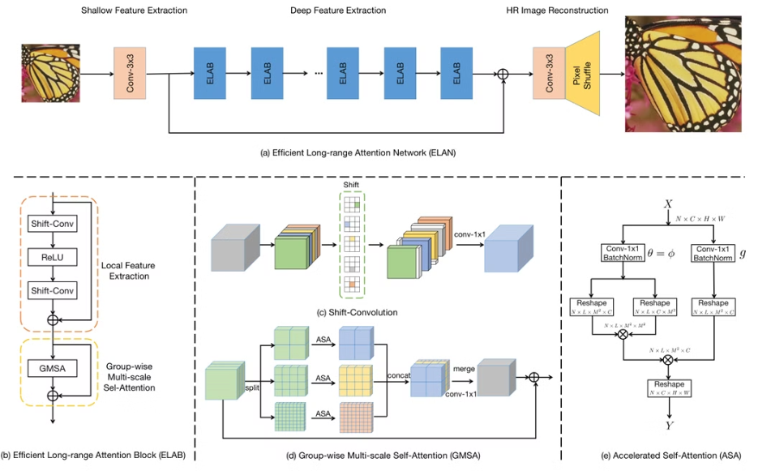
Available Techniques
3) Long Attention Mechanism
The ELAN pipeline has three modules: shallow feature extraction, ELAB-based deep feature extraction, and HR image reconstruction. It uses a global shortcut connection, starting with shallow features from a 3×3 convolution, enhancing degraded low-resolution images for reconstruction.

Slide 9
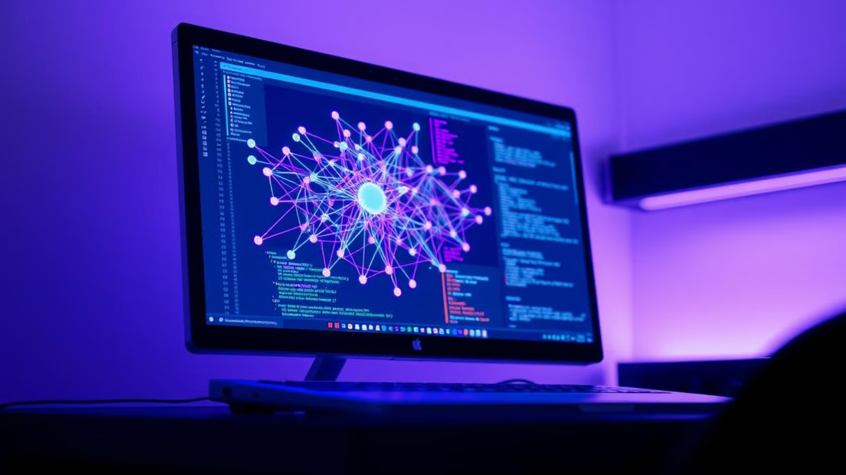
Our Architecture:
1) Convolutional neural network model: The model is used to extract features from the image and pass it to the next layer of the architecture.
2) Generative Advertisal Networks : the extracted features are passed this network to generate the restored image
(or)
2) Transformers: the extracted features are passed to this network with long attention mechanisms to generate a filter that is roller over image to get restored image.

Slide 10
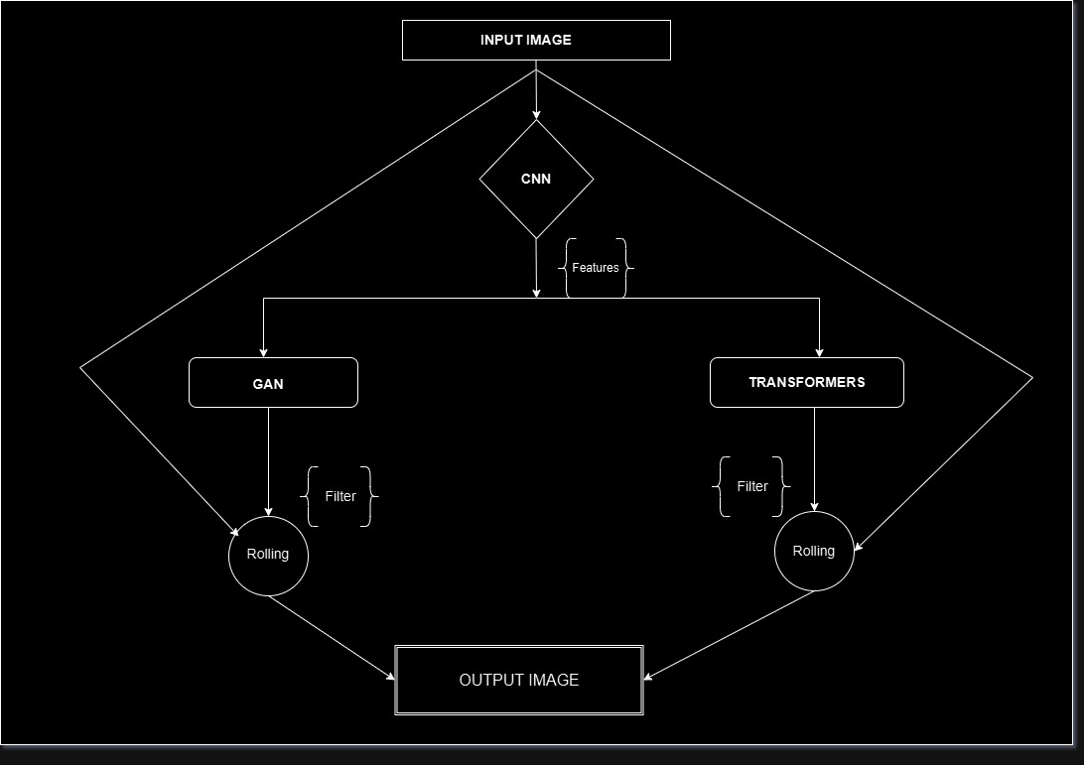
Flow Chart of Proposed Architecture

Slide 11

Conclusion: Key Insights and Future Directions
Future Research
1
Exploring novel deep learning architectures, such as generative adversarial networks (GANs), to further enhance image restoration capabilities.
2
Real-Time Applications
Developing real-time image restoration systems for applications such as video surveillance, medical imaging, and mobile photography.
Integration with Other Tasks
3
Integrating image restoration with other computer vision tasks, such as object detection, image segmentation, and scene understanding.

Slide 12
References
SwinIR: Image Restoration Using Swin Transformer Jingyun Liang1 Jiezhang Cao1 Guolei Sun1 Kai Zhang1* Luc Van Gool12 Radu Timofte1 1Computer Vision Lab, ETH Zurich, Switzerland 2KU Leuven, Belgium jinliang, jiezcao, guosun, kai.zhang, vangool.
Restormer: Efficient Transformer for High-Resolution Image Restoration Syed Waqas Zamir1 Aditya Arora1 Salman Khan2 Munawar Hayat3 Fahad Shahbaz Khan2 Ming-Hsuan Yang456 1Inception Institute of AI 2Mohamed bin Zayed University of AI 3Monash University 4University of California, Merced 5Yonsei University 6Google Research.
Efficient Long-Range Attention Network for Image Super-resolution Xindong Zhang1,2,⋆, Hui Zeng2,⋆, Shi Guo1, and Lei Zhang1,1 Dept. of Computing, The Hong Kong Polytechnic University 2 OPPO Research, China.
DiffIR: Efficient Diffusion Model for Image Restoration Bin Xia 1, Yulun Zhang 2, Shiyin Wang 3, Yitong Wang 3, Xinglong Wu 3, Yapeng Tian 4, Wenming Yang 1, and Luc Van Gool 2 1 Tsinghua University, 2 ETH Z¨ urich, 3 ByteDance Inc, 4 University of Texas at Dallas.
Boosting Image Restoration via Priors from Pre-trained Models Xiaogang Xu1,2,3 Shu Kong5,6,7 Tao Hu3,8 Zhe Liu1* Hujun Bao1,4 1 Zhejiang Lab 2 CUHK 3 RealityEdge 4 Zhejiang University 5 University of Macau 6 Institute of Collaborative Innovation 7 Texas A&M University 8 National University of Singapore.

